Slide 1
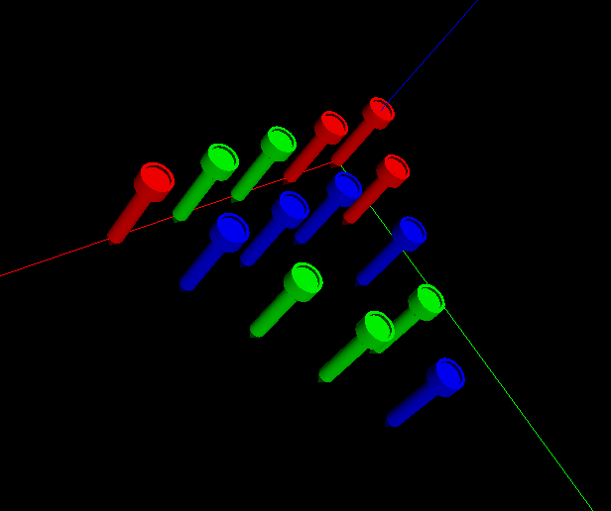
Triangle Peg Game Modeling
Adam. K., Jiazhong. Z., Fei. X.
2015.12

Slide 2

Goals

Slide 3
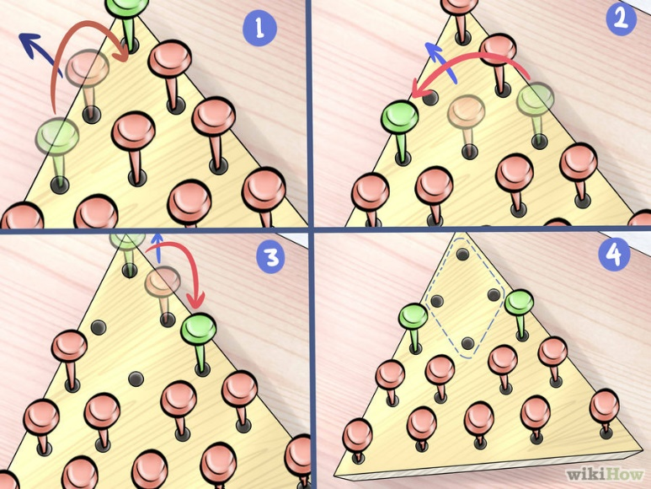
Objectives: Modeling Triangle Peg Game
You must jump each peg over another peg, but only if there is an open space
Each peg you jump over must be removed
You win if only one peg is left at the end of the game

Slide 4
Modeling Procedures

Slide 5
Modeling Procedures:
Model the surface of the triangular pad with holes, and all the tees
Model the beer cup and table with primitives.
A triggered light source on the tees.
Mapping a texture to a cup to represent a cup of beer.
A bump mapping for the table
Navigation with mouse by clicking
Interaction by keyboard.
A triggered animation and each object (tee) will have multiple paths.

Slide 6
Objects Modeling

Slide 7
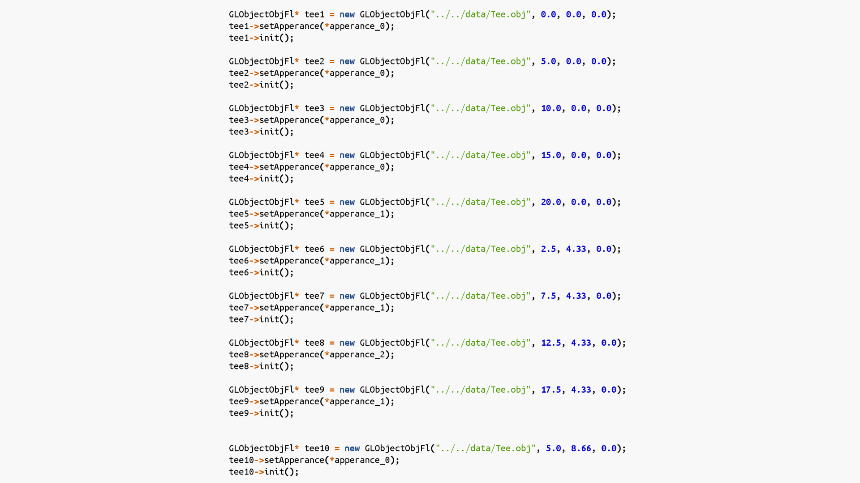
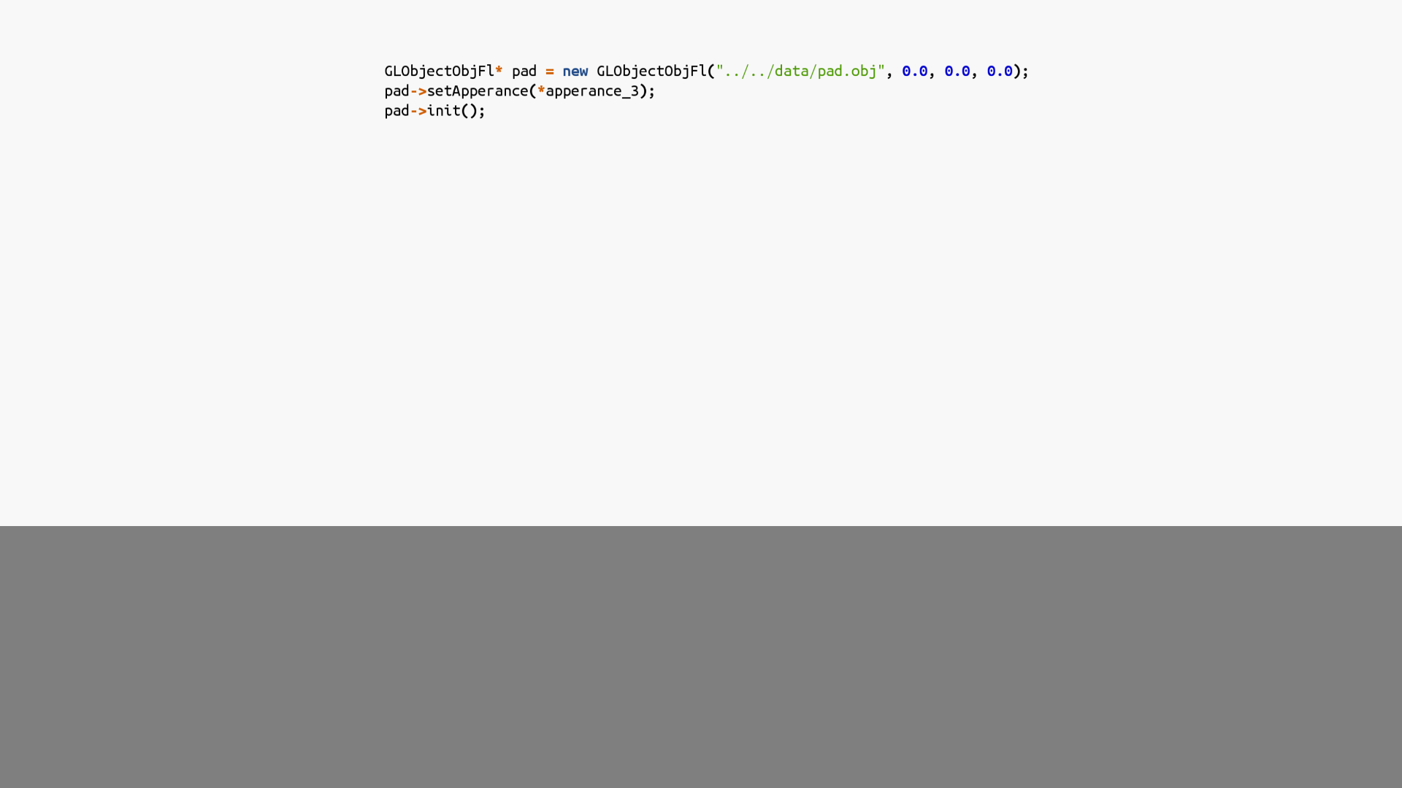
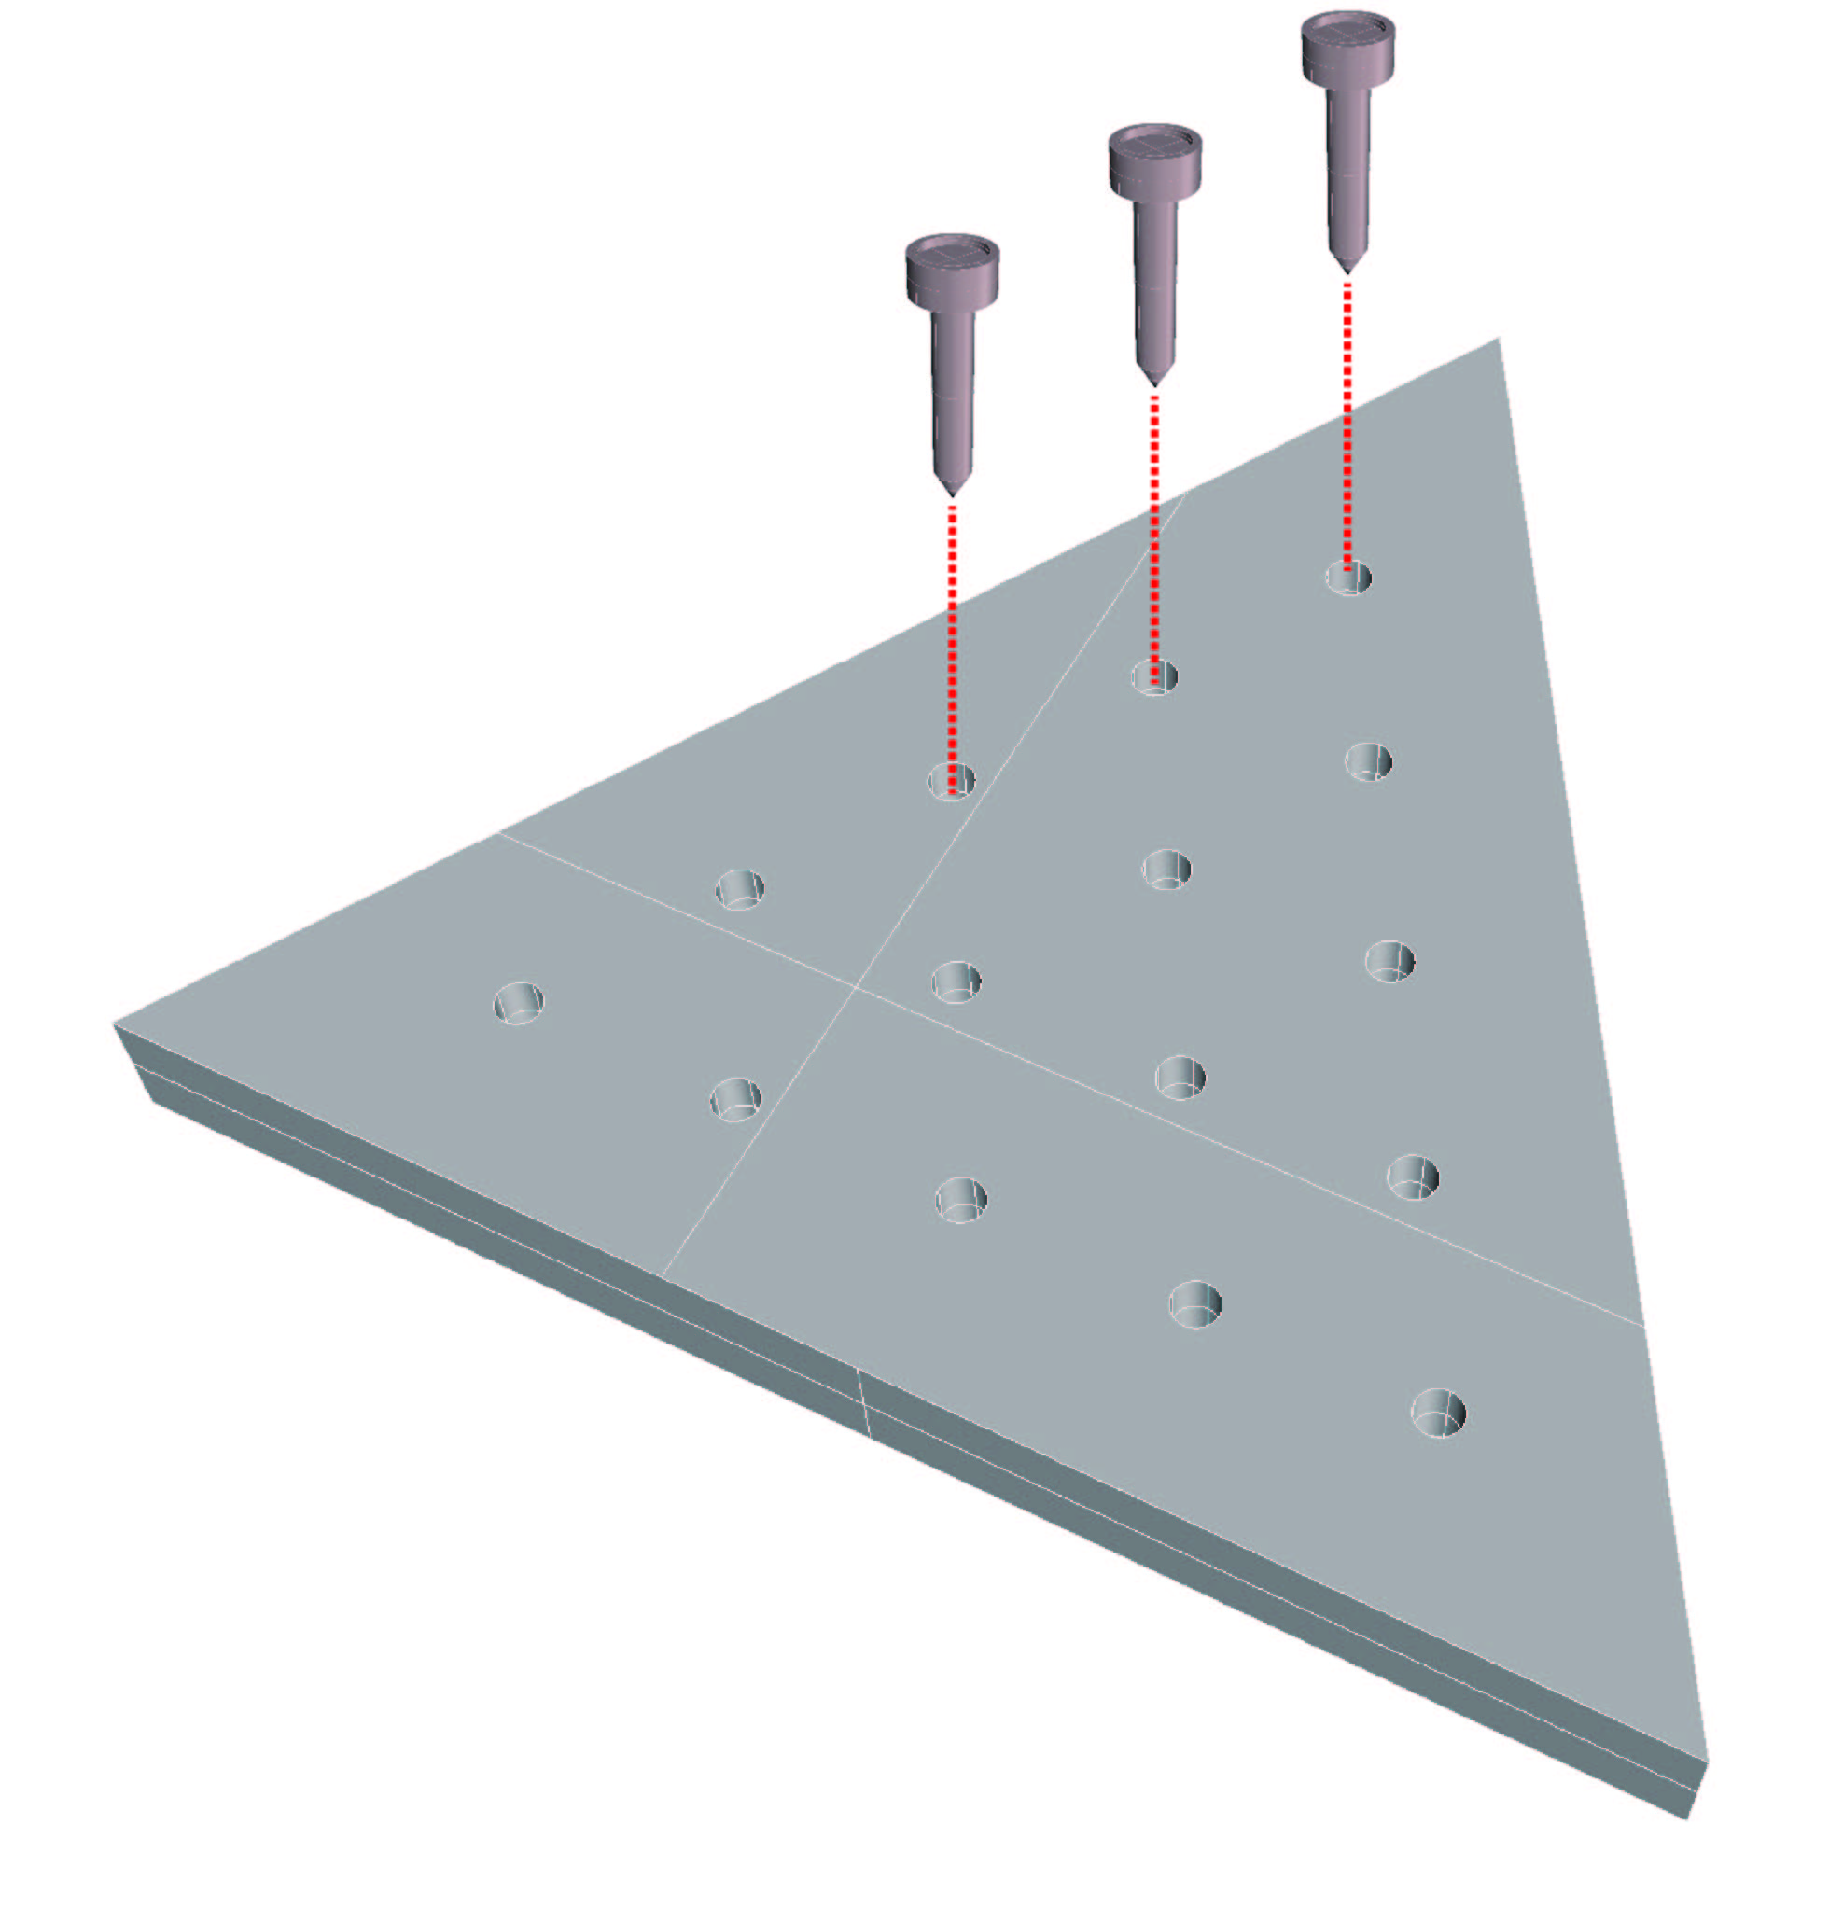
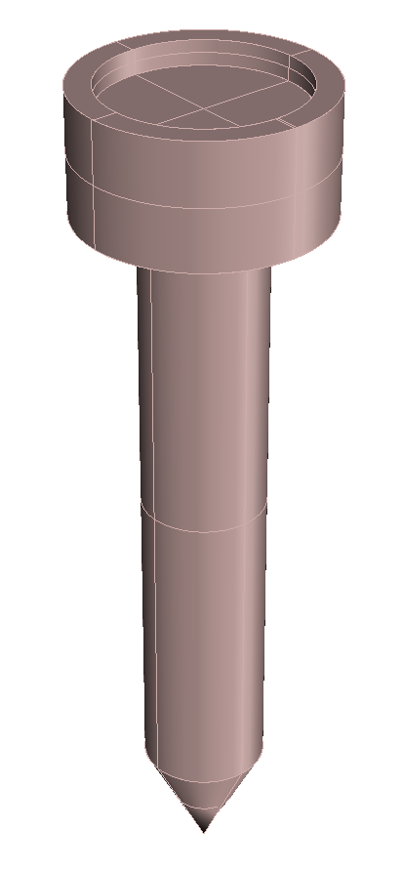
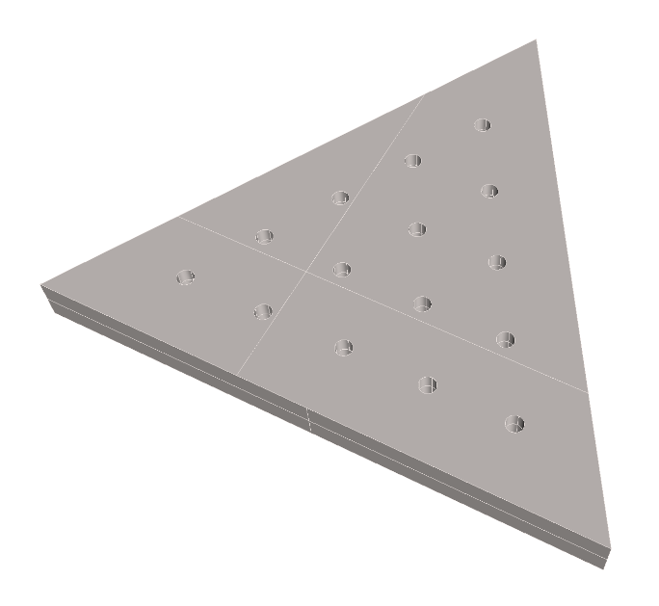
Loaded objects:

Slide 8

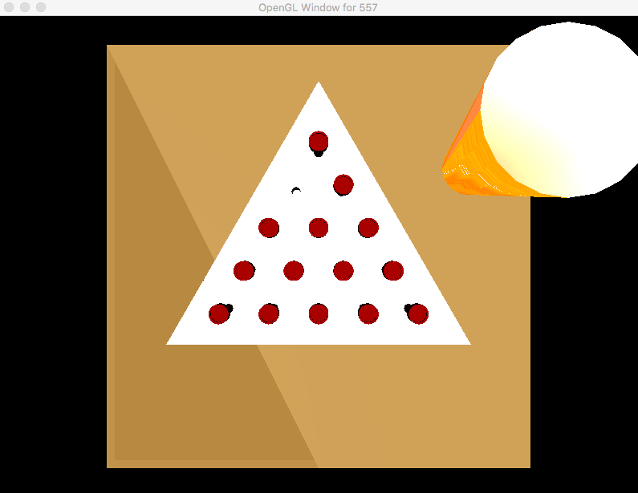
Primitives: table and cup
Cup: Table:

Slide 9
Lighting

Slide 10
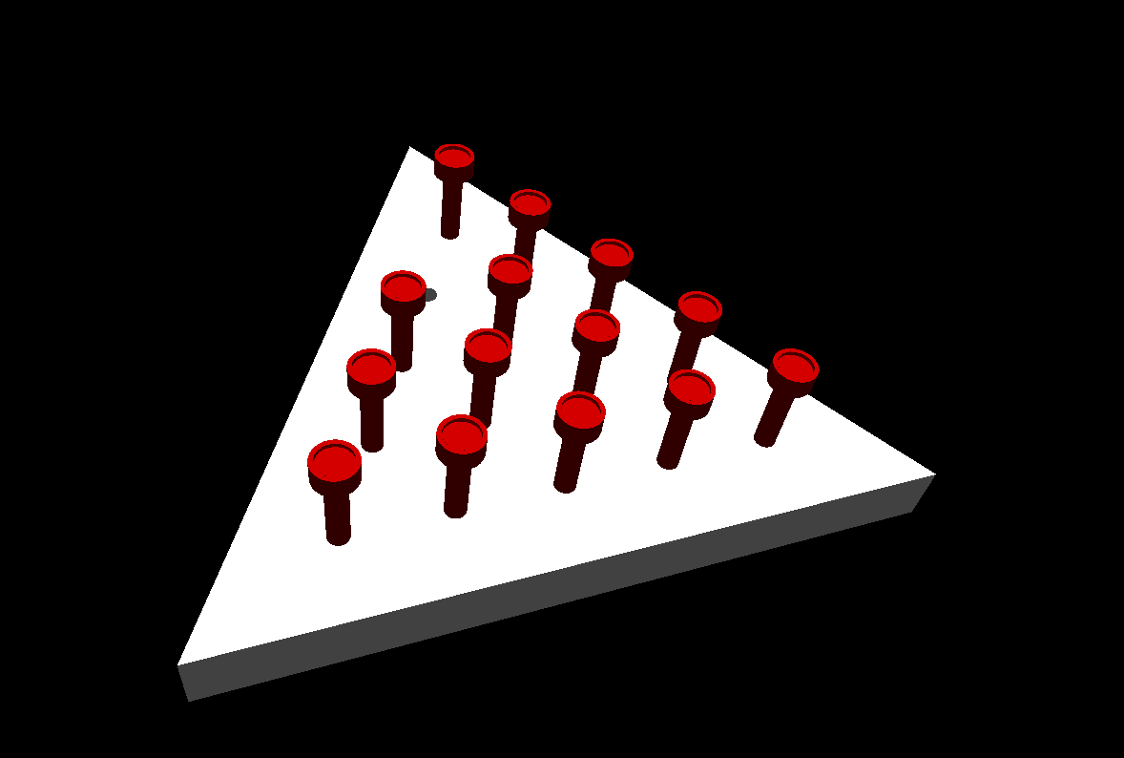
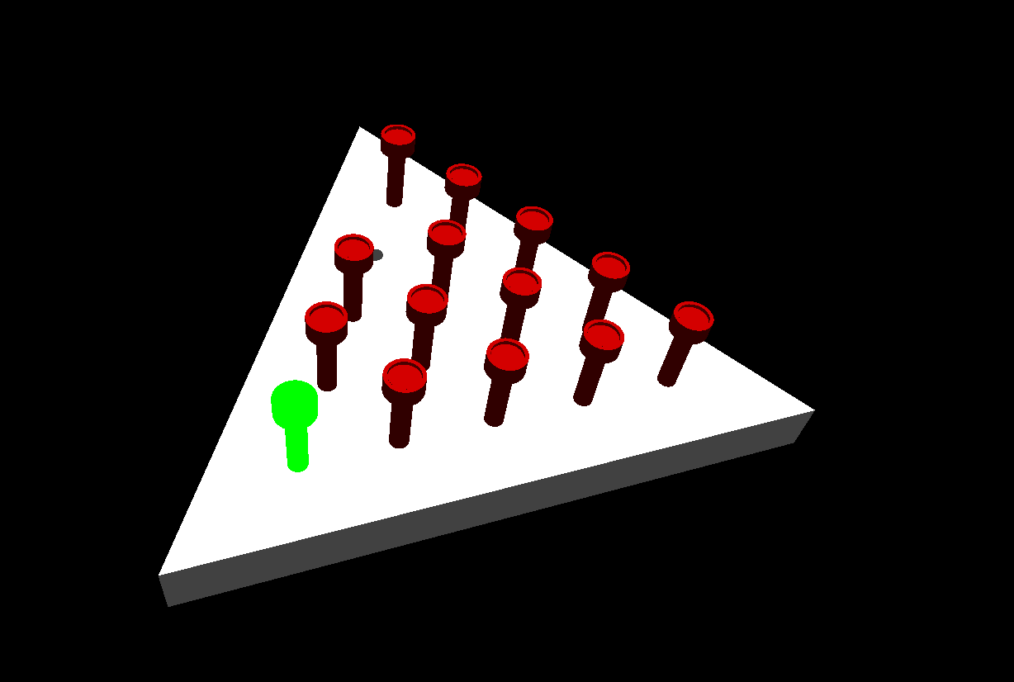
Lighting
A lighting triggered by the mouse picking.

Slide 11
Texturing

Slide 12

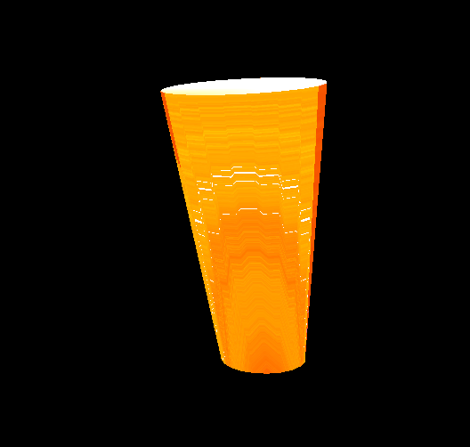
Texture for a cup of beer
We map the texture of a beer bubbles to a cup (built by primitives).

Slide 13
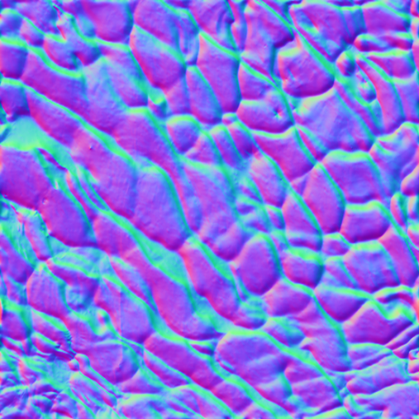
Displacement mapping for the table
We combine us the water map to make a texture like a wooden texture.

Slide 14
Interaction

Slide 15
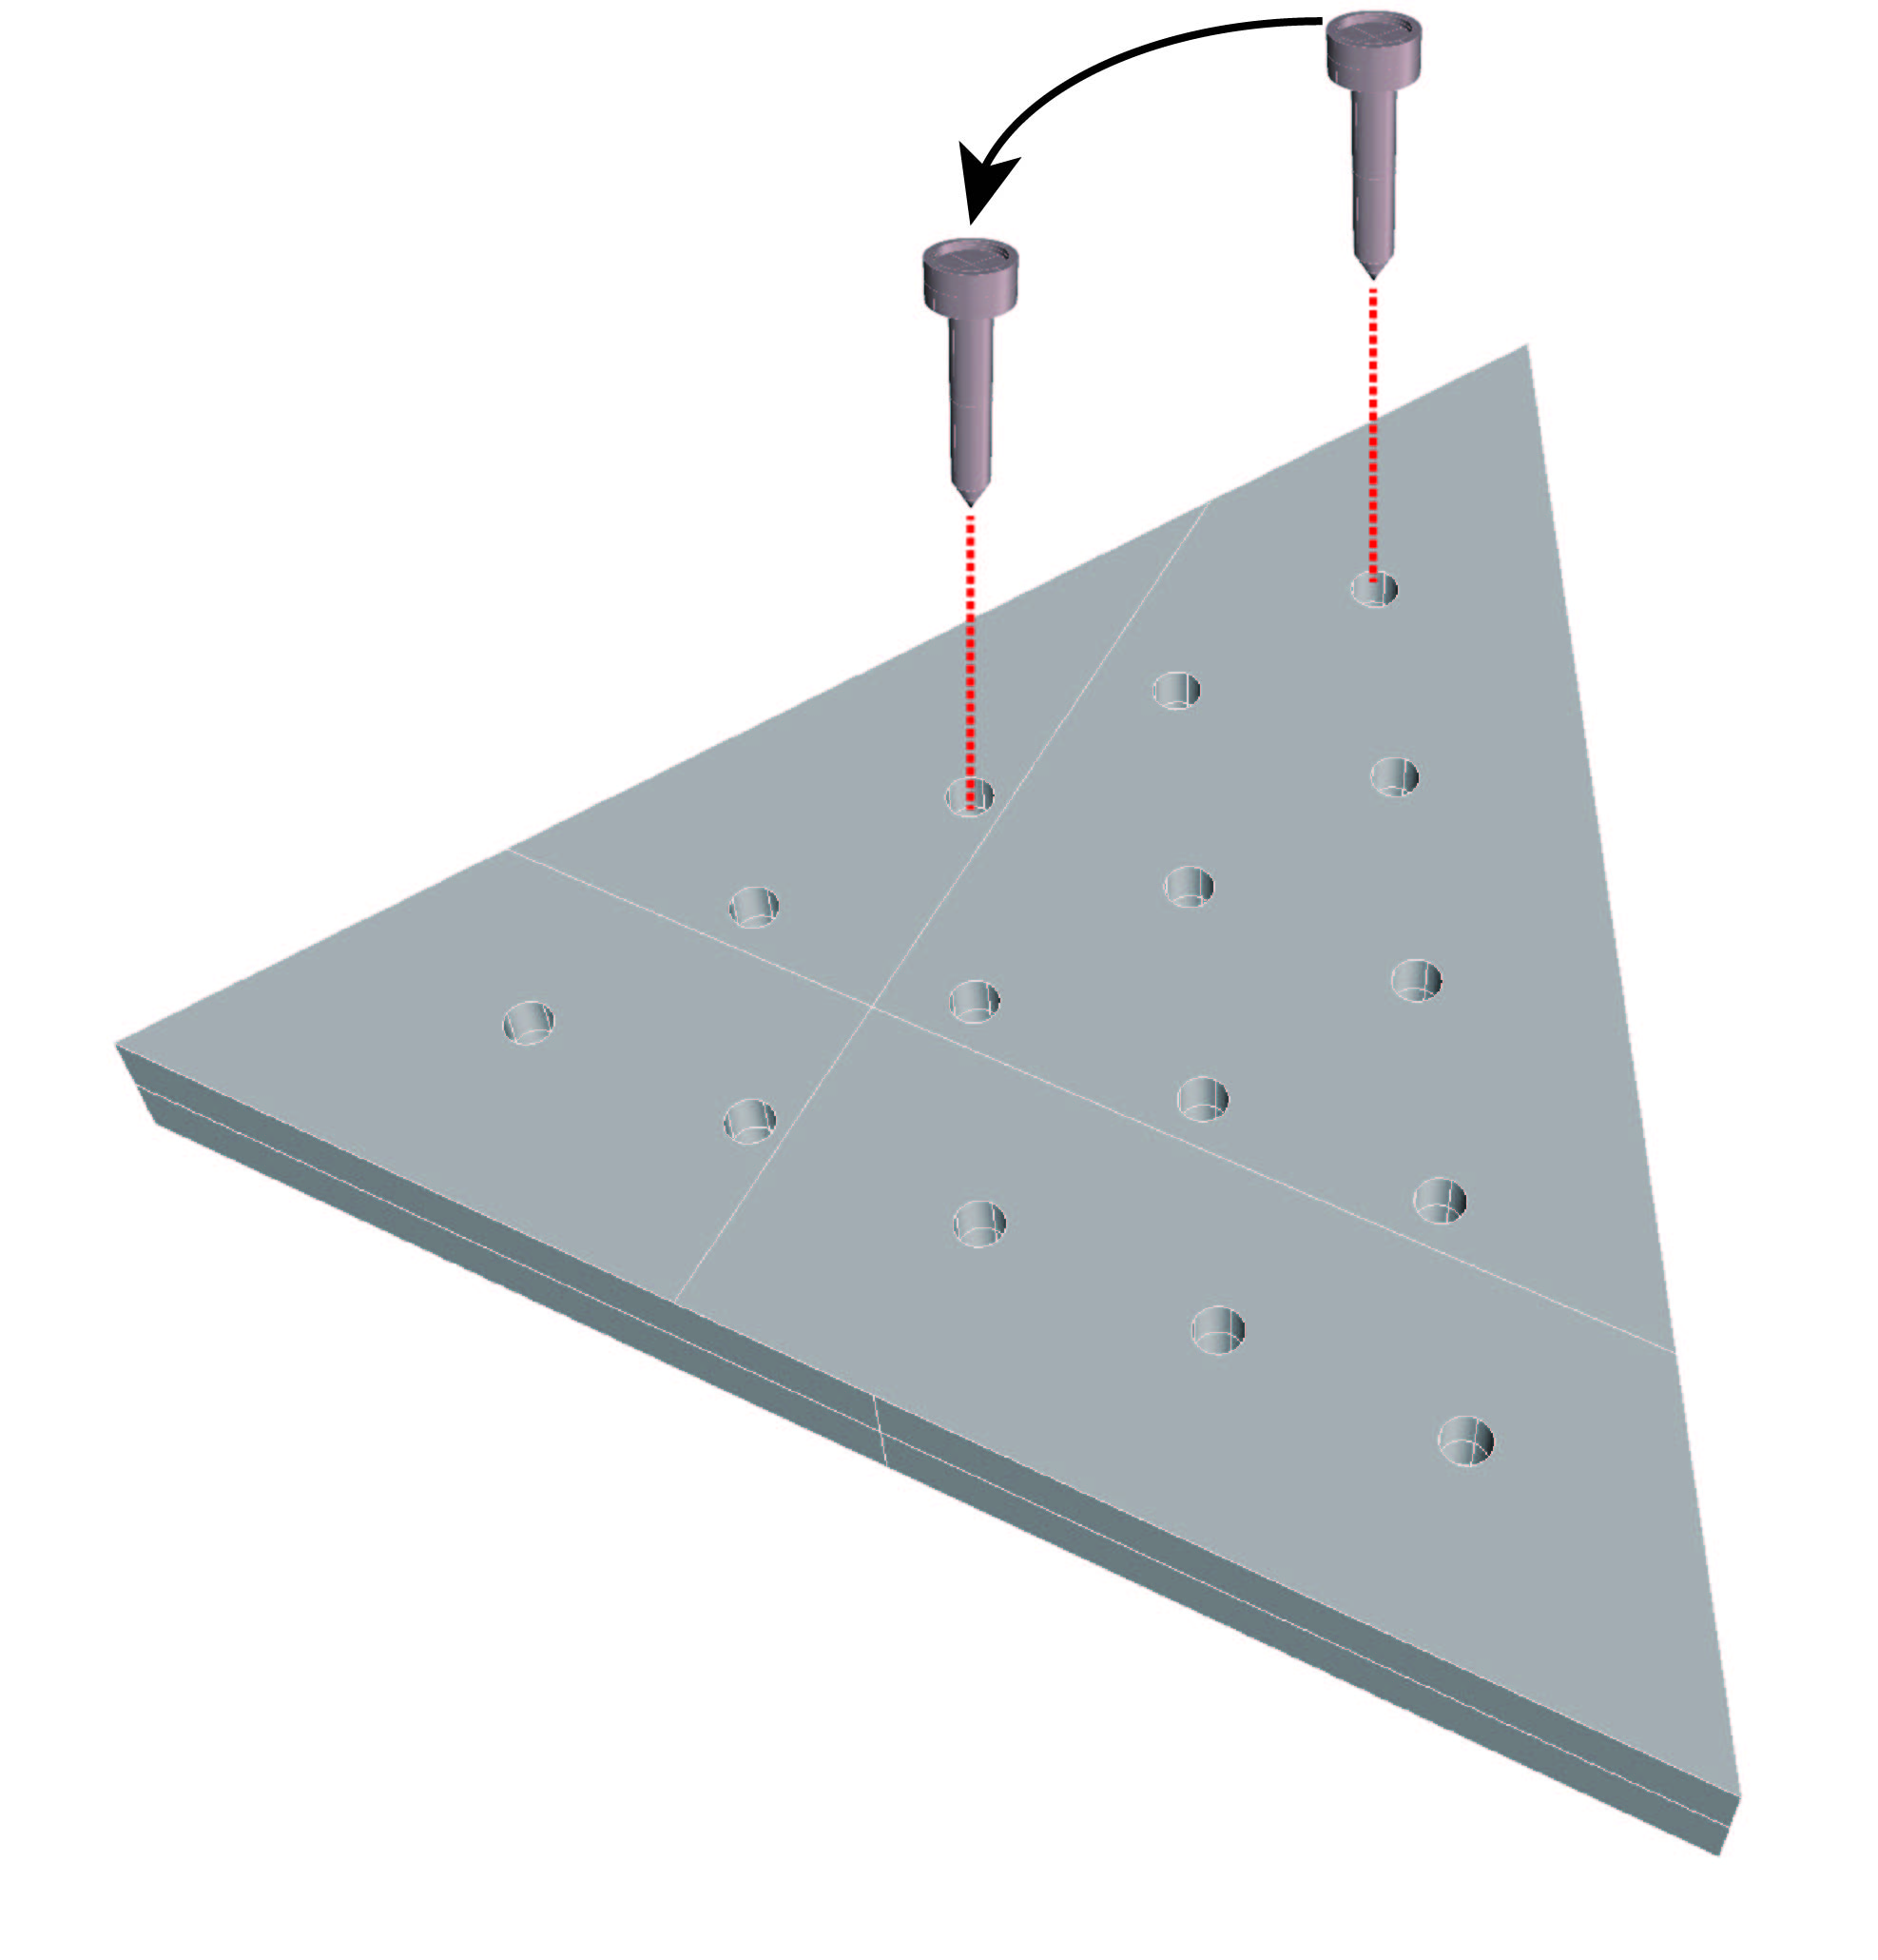
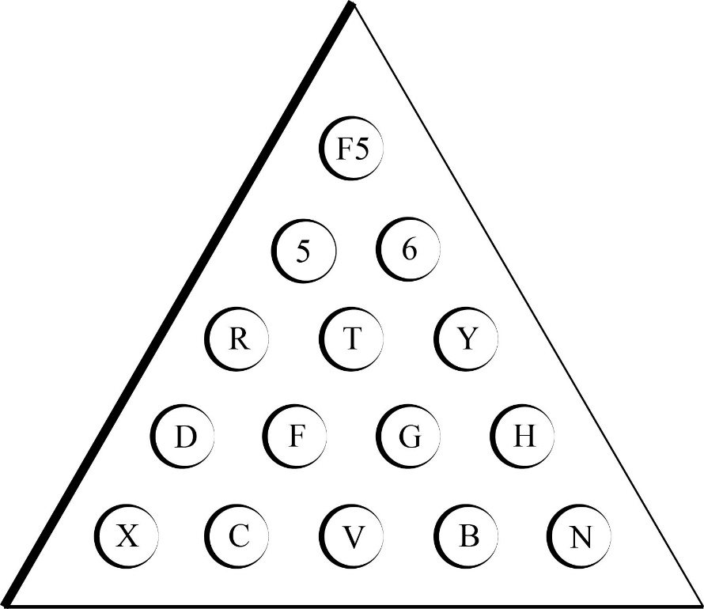
Object User Interaction:
Each of those keys corresponds to a certain destination.
R

Slide 16


Object Triggered Animations with Multiple Paths:
1
5
2
3
4
X
5
6

Slide 17
Animation

Slide 18
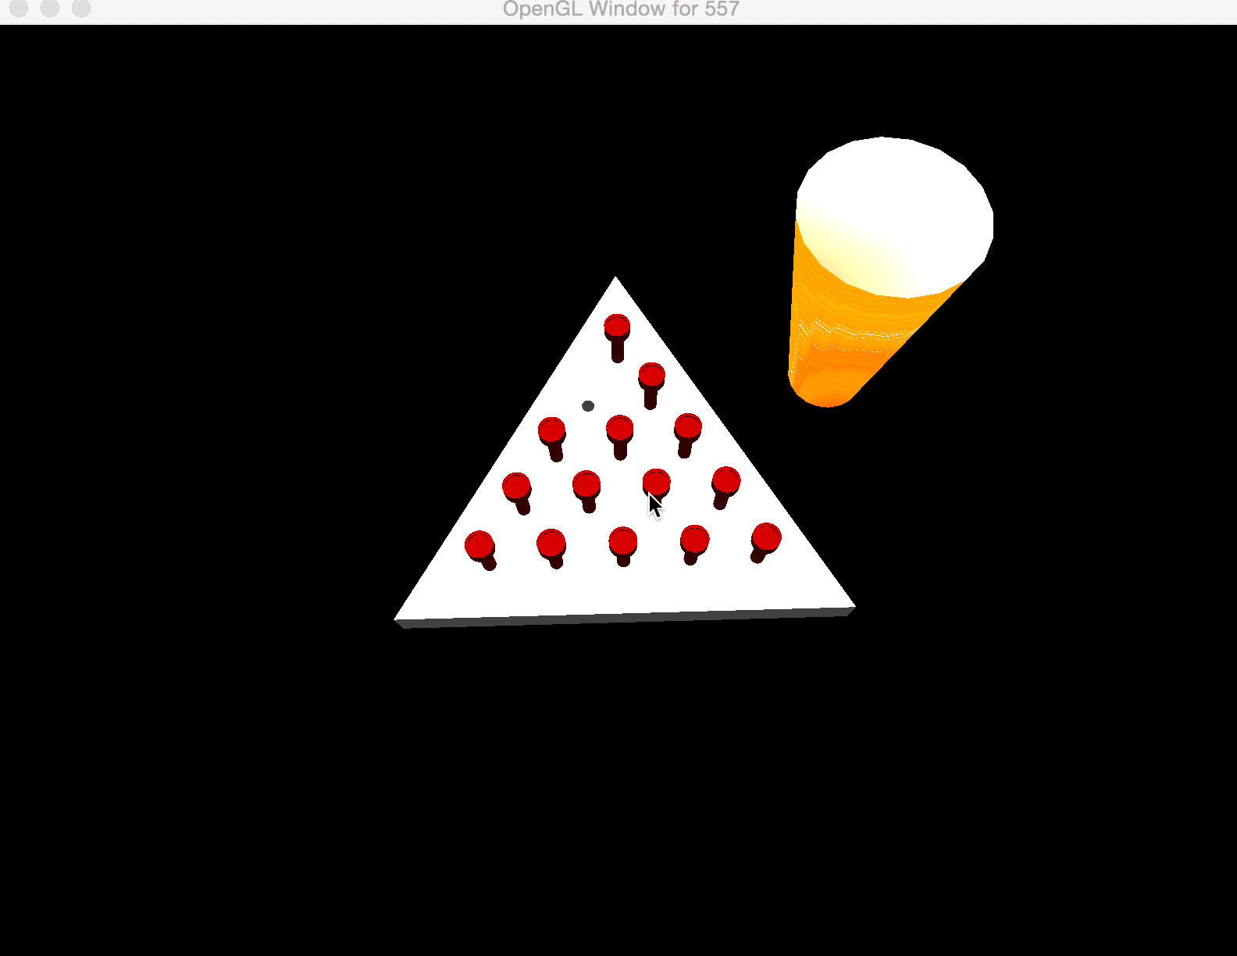
Use the mouse to pick; use the keyboard to move.
The tees passed by will be eliminated.

Slide 19
The Final Appearance

Slide 20
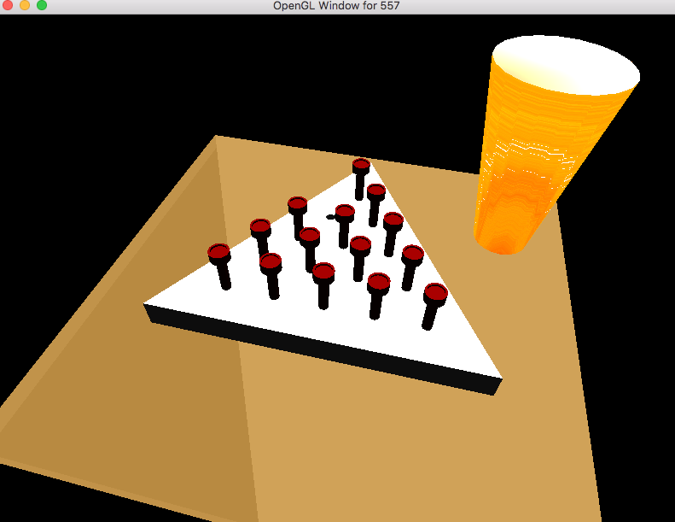

Slide 21
Project Completion Degree
 | Modeling | Light | Appearance (Material) | Navigation / interaction | Keyframe Animation
1 | Single primitive or loaded objects | You need a single light | Basic specular + diffuse reflect code | Trackball navigation | Single linear transformation
2 | Multiple primitives | Combined Spot+direct+point light | Texturing | Navigation in 3D | Animation with rotation and translation
3 | Complex object surface | Combined light on surface | Multi-Texturing | Navigation with keyboard + mouse | Triggered (keyboard,etc.) animations
4 | Hierarchical model | Combined colored light on surface | Environment Mapping | Navigation along a surface | Animation with collision detection
5 | Hierarchical model, h>2 | Triggered light source | Bump or Displacement Mapping | Navigation with multiple cameras | Multiple animation paths per object

